Slide 1

19ECS 773: Deep Learning
Topic: Feed Forward Neural Networks
Unit I
April 16 2021, 2.00-3.00PM
Dr. Sireesha Rodda
Professor,
Dept of CSE,
GITAM Institute of Technology
GITAM Deemed to be University

Slide 2

Outline
What are Neural Networks?
Biological Neural Networks
ANN – The basics
Feed forward net
Training
Example – Voice recognition
Applications – Feed forward nets

Slide 3
What are Neural Networks?
Models of the brain and nervous system
Highly parallel
  Process information much more like the brain than a serial computer
Learning
Very simple principles
Very complex behaviours
Applications
  As powerful problem solvers
  As biological models

Slide 4
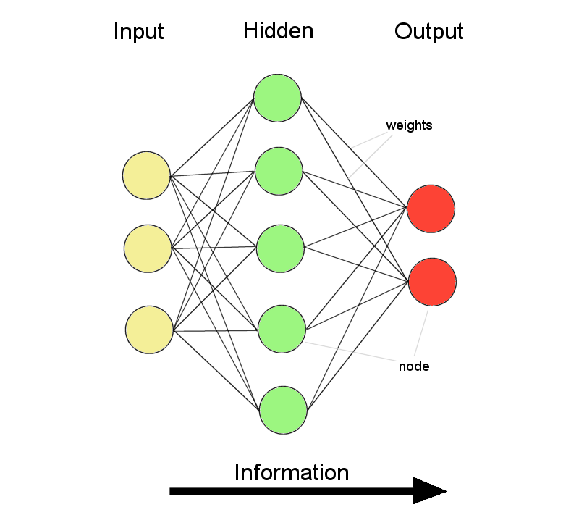
ANNs – The basics
ANNs incorporate the two fundamental components of biological neural nets:
Neurons (nodes)
Synapses (weights)

Slide 5
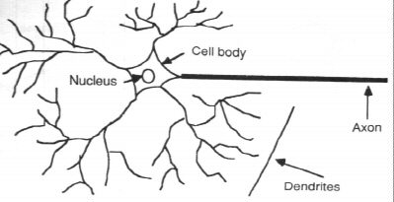
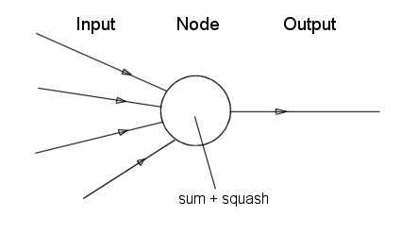
Neurone vs. Node

Slide 6
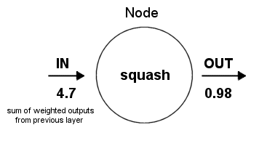
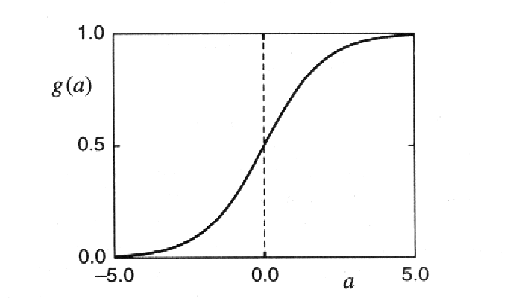
Structure of a node:
Squashing function limits node output:

Slide 7
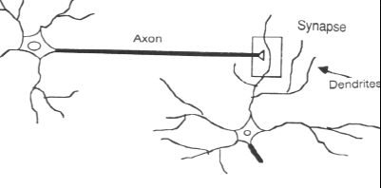
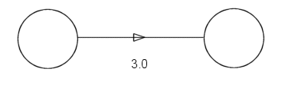
Synapse vs. weight

Slide 8
Feed-forward nets
Information flow is unidirectional
  Data is presented to Input layer
  Passed on to Hidden Layer
  Passed on to Output layer
Information is distributed
Information processing is parallel
Internal representation (interpretation) of data

Slide 9
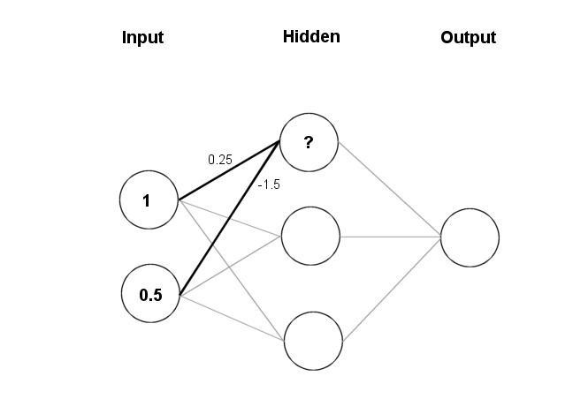
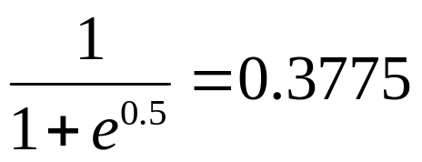
Feeding data through the net:
(1 × 0.25) + (0.5 × (-1.5)) = 0.25 + (-0.75) = - 0.5
Squashing:

Slide 10
Data is presented to the network in the form of activations in the input layer
Examples
  Pixel intensity (for pictures)
  Molecule concentrations (for artificial nose)
  Share prices (for stock market prediction)
Data usually requires preprocessing
  Analogous to senses in biology
How to represent more abstract data, e.g. a name?
  Choose a pattern, e.g.
    0-0-1 for “Chris”
    0-1-0 for “Becky”

Slide 11
Weight settings determine the behaviour of a network
→ How can we find the right weights?

Slide 12
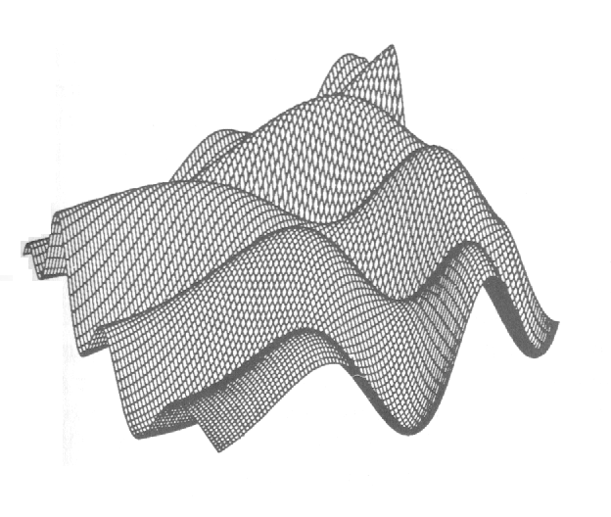
Training the Network - Learning
Backpropagation
  Requires training set (input / output pairs)
  Starts with small random weights
  Error is used to adjust weights (supervised learning)
  → Gradient descent on error landscape

Slide 13
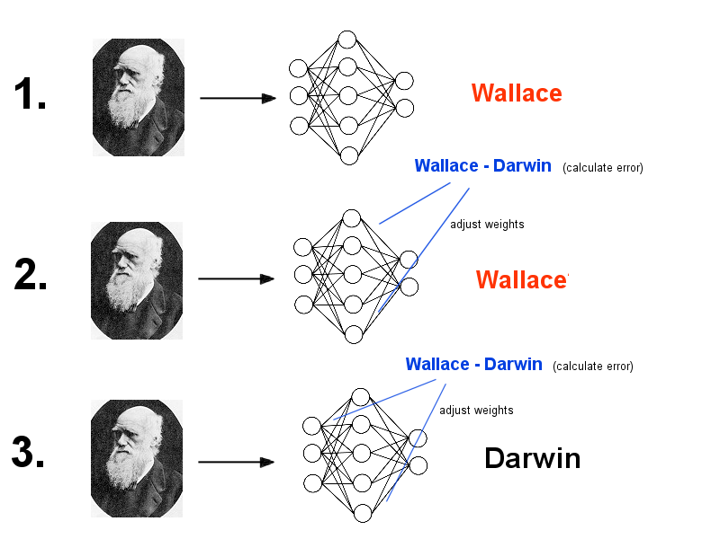

Slide 14
Advantages
  It works!
  Relatively fast
Downsides
  Requires a training set
  Can be slow
  Probably not biologically realistic
Alternatives to Backpropagation
  Hebbian learning
    Not successful in feed-forward nets
  Reinforcement learning
    Only limited success
  Artificial evolution
    More general, but can be even slower than backprop

Slide 15
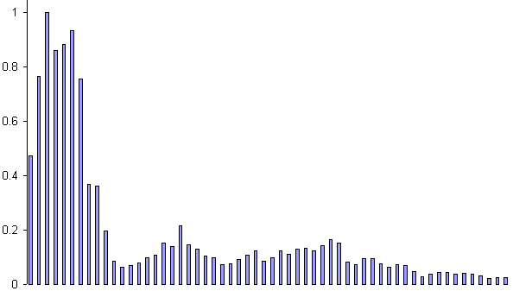
Example: Voice Recognition
Task: Learn to discriminate between two different voices saying “Hello”
Data
  Sources
    Steve Simpson
    David Raubenheimer
  Format
    Frequency distribution (60 bins)
    Analogy: cochlea

Slide 16
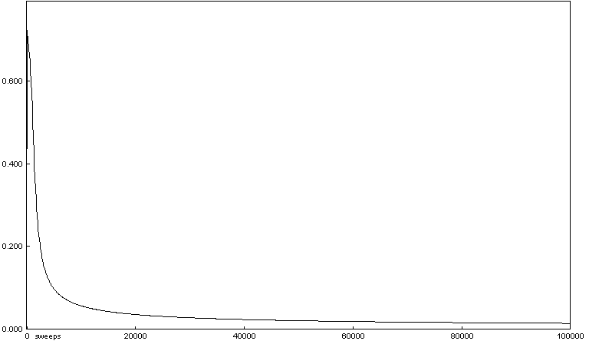
Repeat process (sweep) for all training pairs
  Present data
  Calculate error
  Backpropagate error
  Adjust weights
Repeat process multiple times

Slide 17
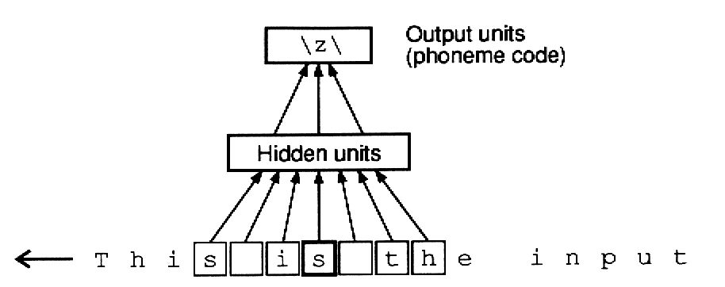
Applications of Feed-forward nets
  Pattern recognition
    Character recognition
    Face Recognition
  Sonar mine/rock recognition (Gorman & Sejnowksi, 1988)
  Navigation of a car (Pomerleau, 1989)
  Stock-market prediction
  Pronunciation (NETtalk)
  (Sejnowksi & Rosenberg, 1987)

Slide 18
Thank You!

